Slide 1

SQL Project Presentation: Bank Analysis
Eric Ye
Instructor: Tareq Jaber
Metro College of Technology
April 14th, 2021

Slide 2
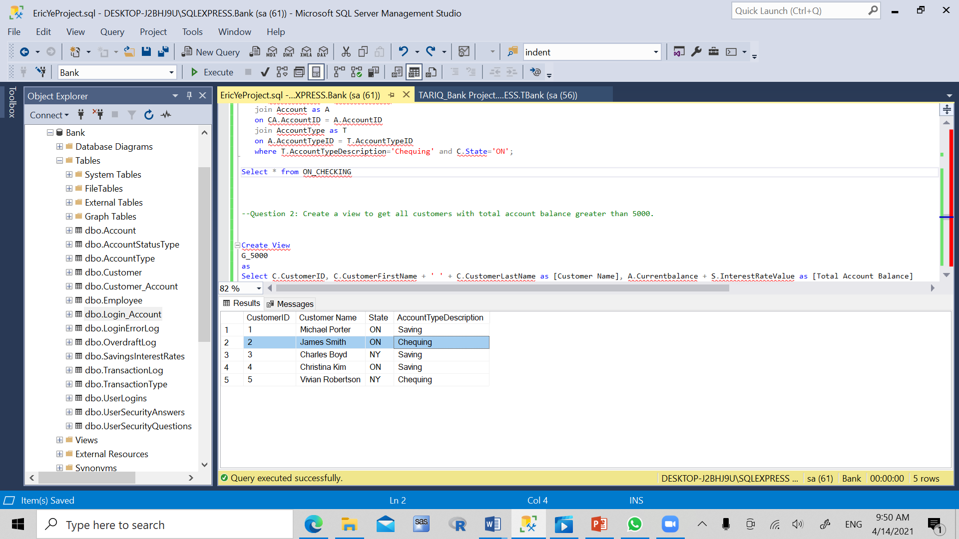
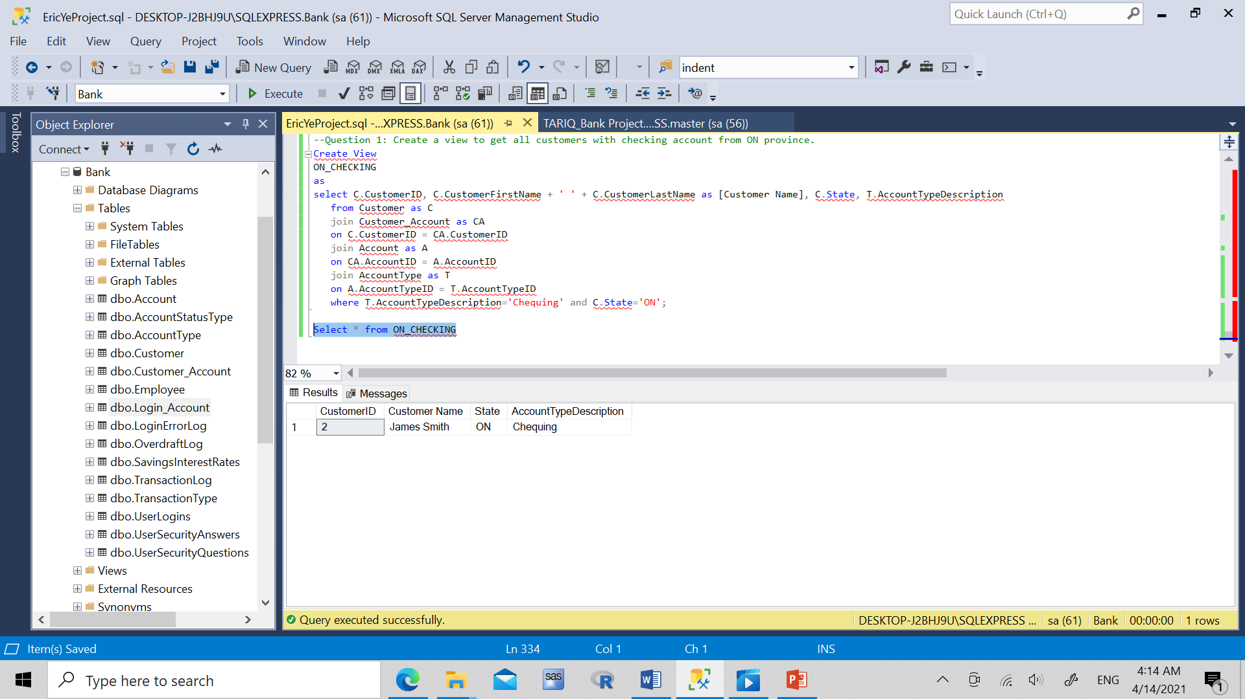
Question 1
Extracting customers with checking account from Ontario province

Slide 3
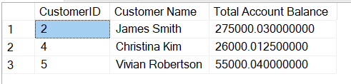
Question 2
Extracting customers with total account balance greater than 5000

Slide 4
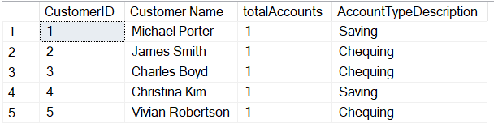
Question 3
Counts of checking and savings accounts by customer.

Slide 5
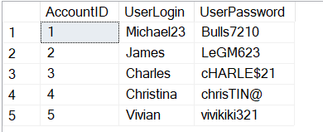
Question 4
Get any particular user’s login and password using AccountID

Slide 6
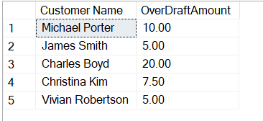
Question 5
Get all customers’ overdraft amount

Slide 7
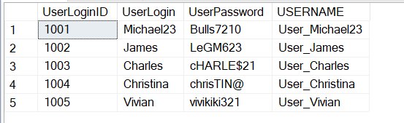
Question 6
Add “User_” to everyone’s login username

Slide 8
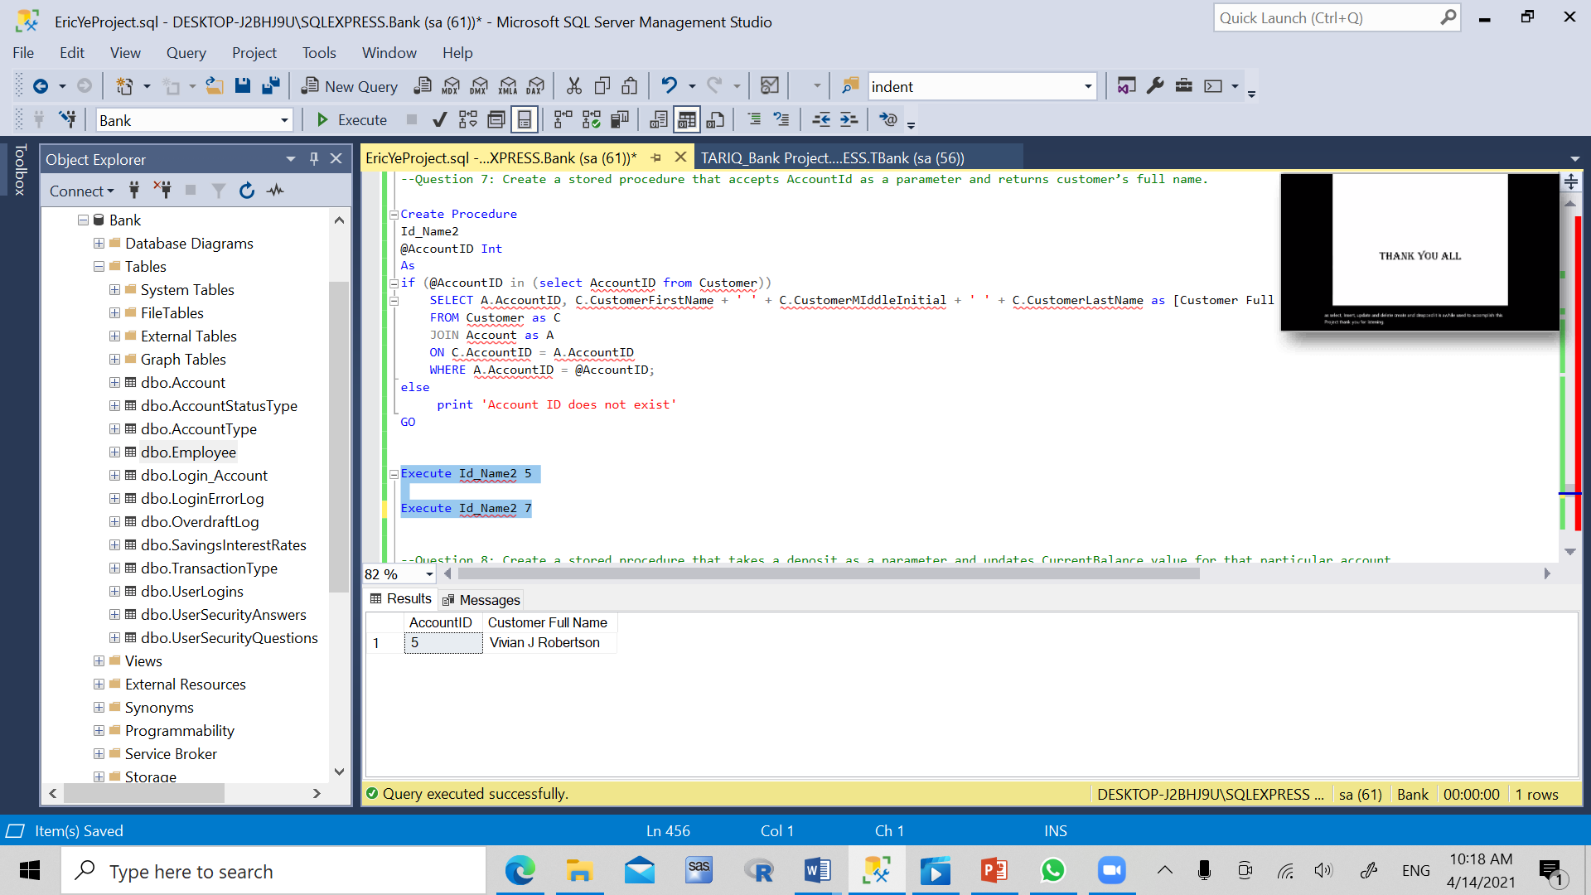
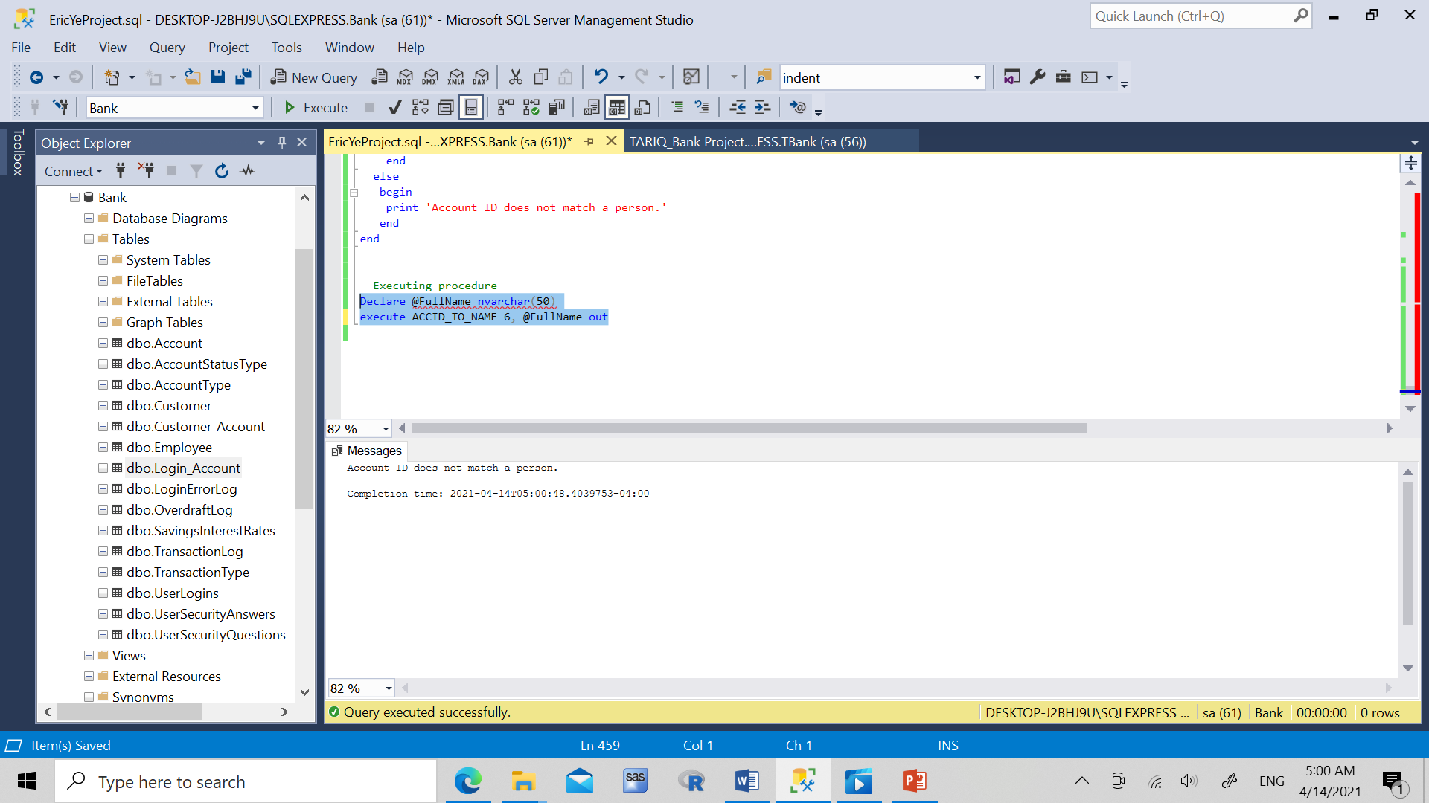
Question 7
Accept AccountId as a parameter and return customer’s full name

Slide 9
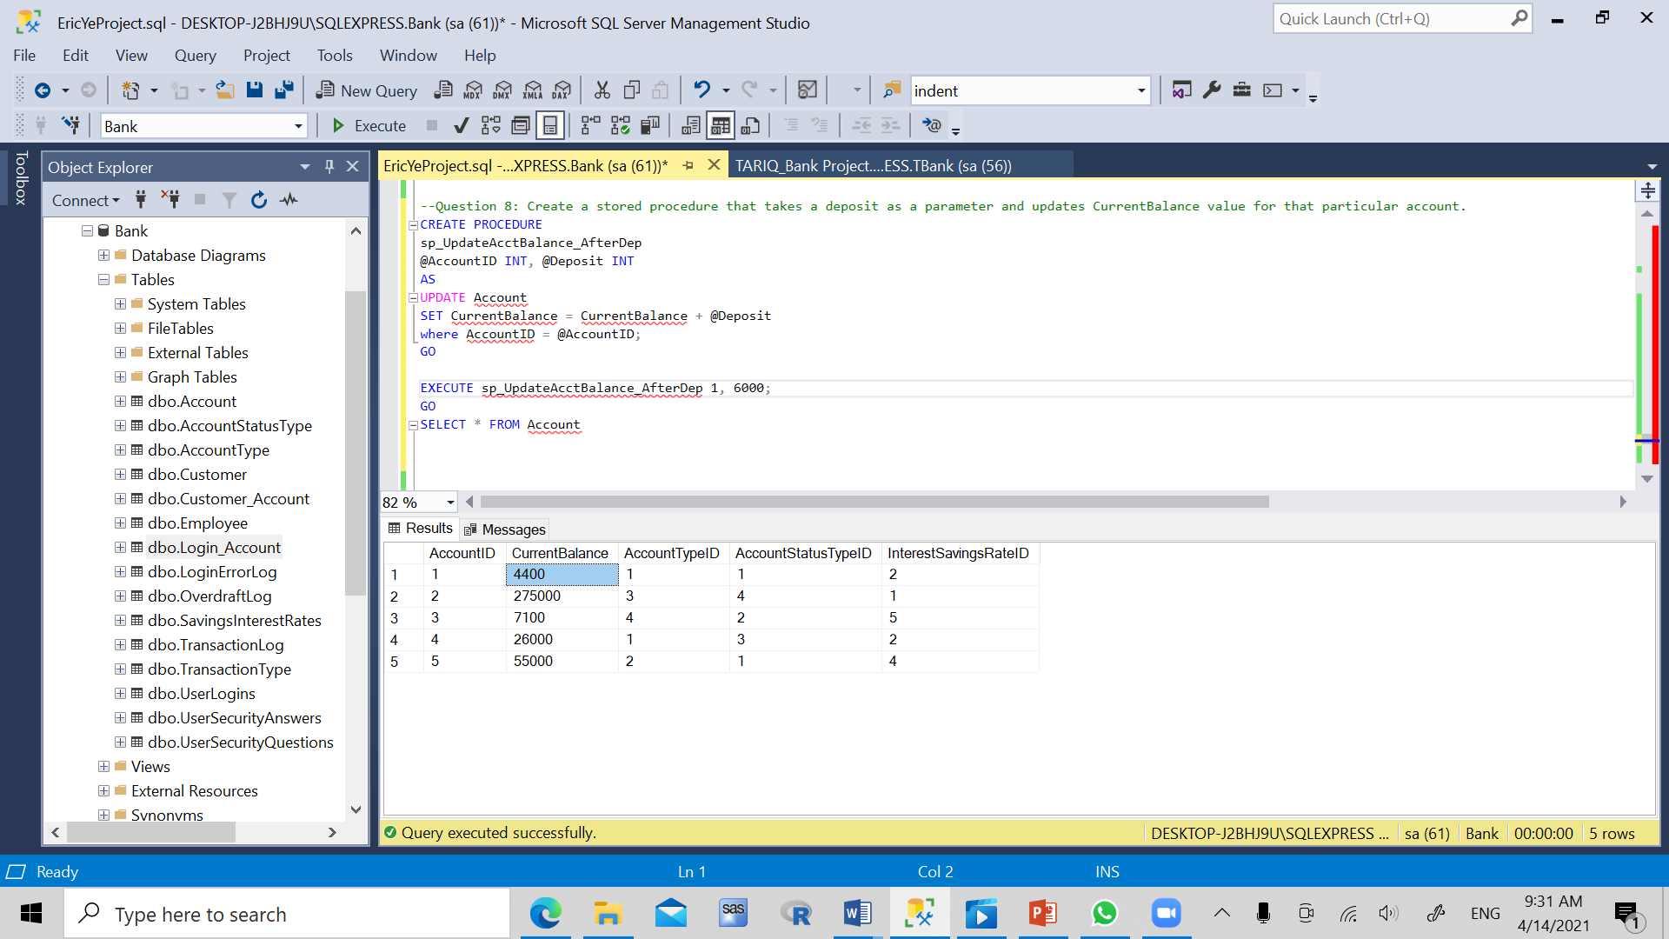

Question 8
Take a deposit as a parameter and updates CurrentBalance value for that particular account.

Slide 10
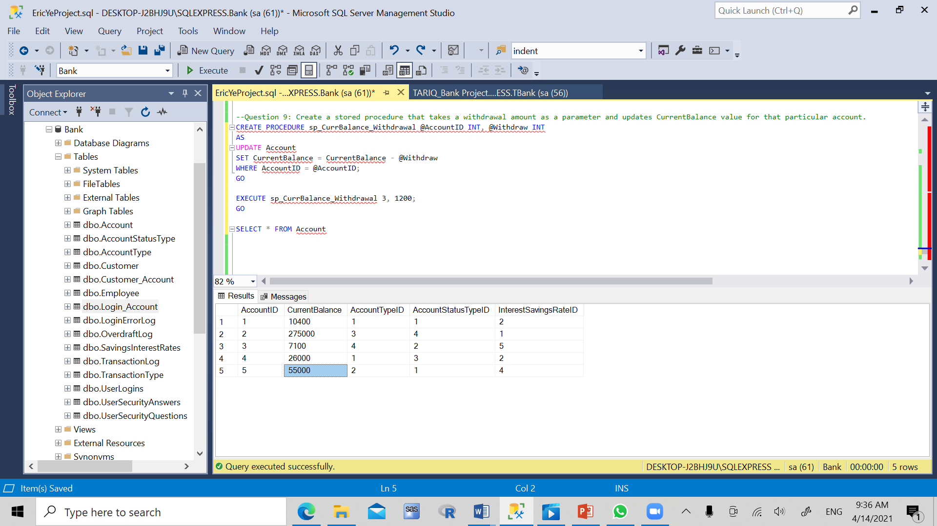
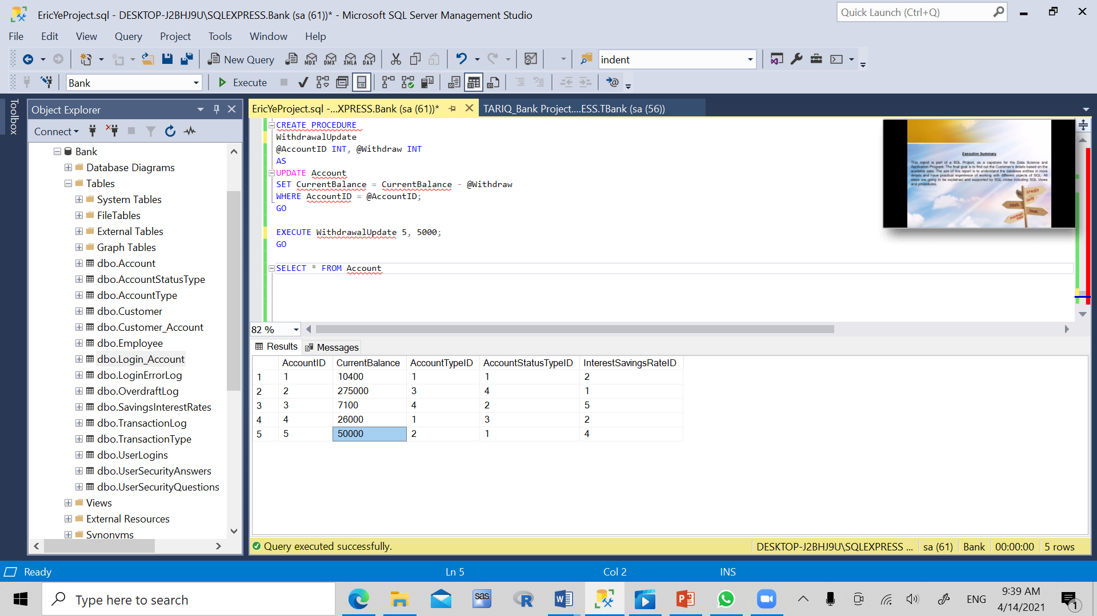
Question 9
Use withdrawal amount as a parameter and updates CurrentBalance value for that particular account.

Slide 11
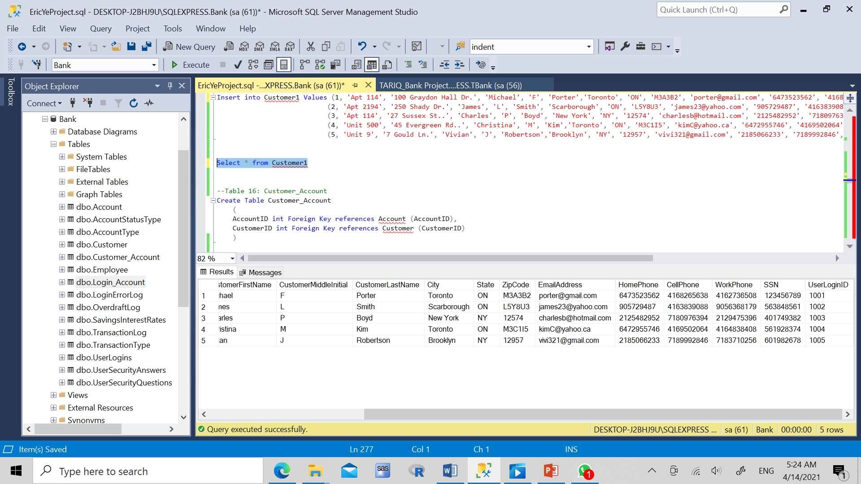
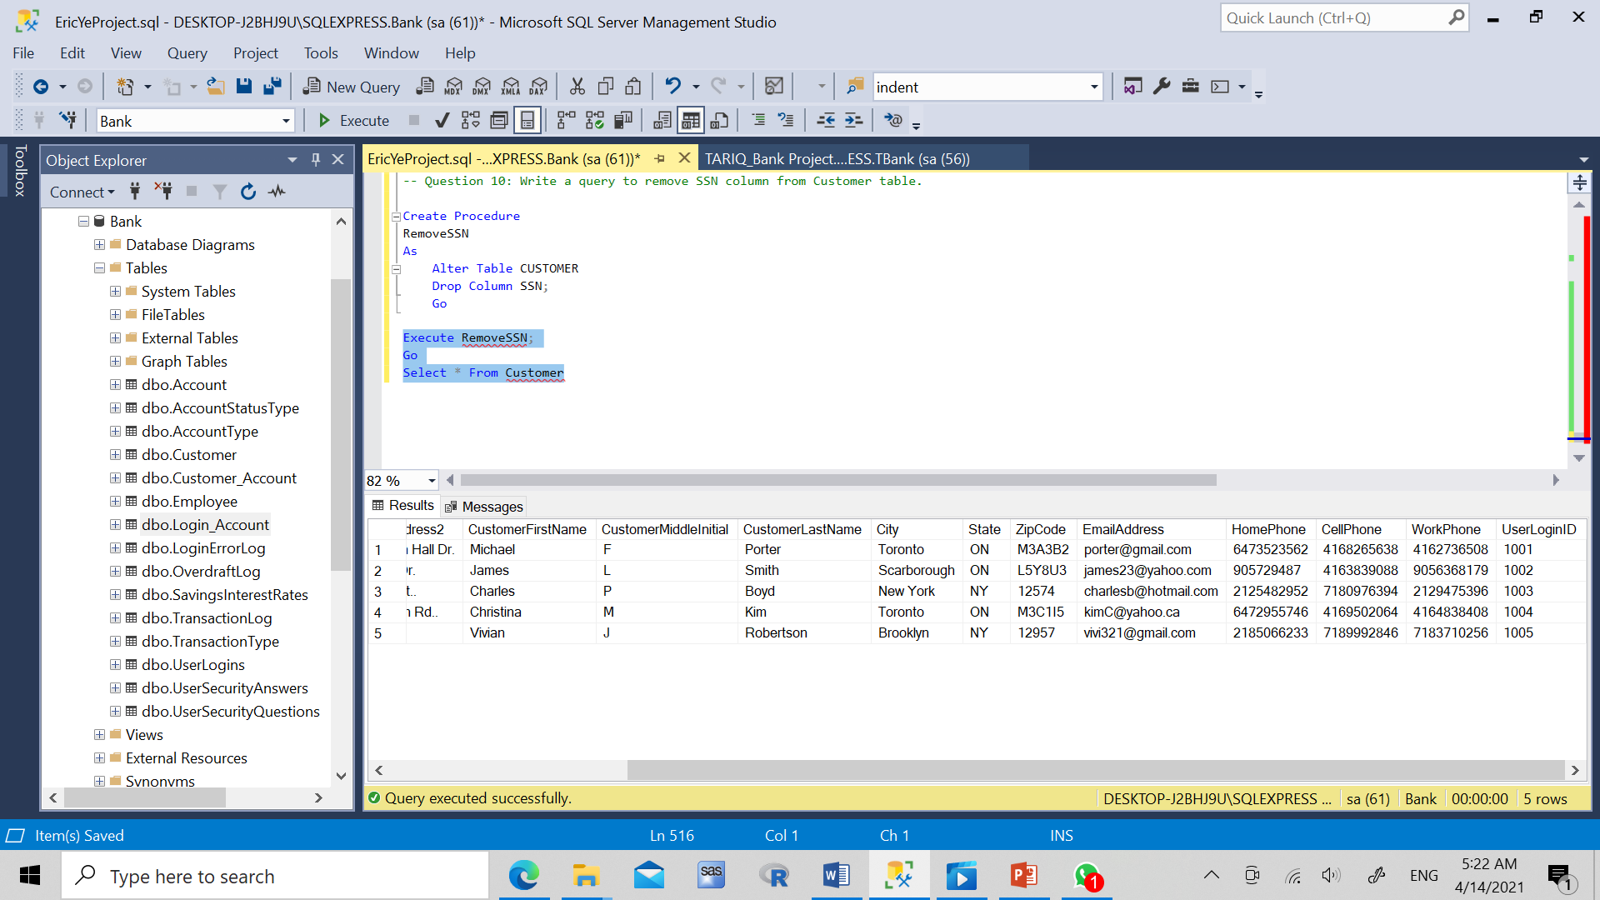
Question 10

Slide 12

Thank you!
Questions?

